Slide 1
FCGAT: Interpretable Malware Classification Method using Function Call Graph and Attention Mechanism
BAR 2023
March 3, 2023
Minami Someya*† Yuhei Otsubo†* Akira Otsuka*
* Institute of Information Security, Japan
† National Police Agency, Japan
Notes:
Hello everyone. My name is Minami Someya. I’m a member of Institute of Information Security and National Police Agency in Japan. In this presentation I’m going to introduce FCGAT, an interpretable Malware Classification Method.

Slide 2
Malware Classification
Identifies malware family or category
Usefulness of malware classification:
Understands malware behavior
Helps with malware analysis
Limitations of conventional signature-based methods:
Cannot keep up with creating pattern files of new malware
Solution:
Use machine learning to classify malware
Emotet, Trickbot …
Downloader,
Ronsomware …
Notes:
Let me start by giving a bit of background. Our objective is to classify malware, by identifying malware families or categories they belong to. This makes it easier for analysts to understand their behavior and helps with malware analysis.
Conventional signature-based methods have limitations that can not keep up with creating pattern files of new malware. To overcome this problem, we use machine learning to classify malware.

Slide 3
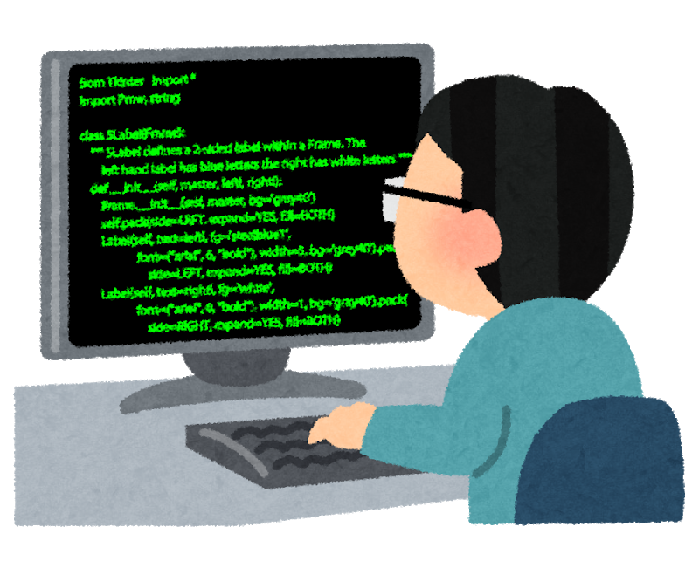



Drawbacks in ML Method: Lack of Interpretability
ML-models are often treated as black boxes
Model interpretability and performance are often in a trade-off relationship
Why Trickbot?
Where’s the malicious code?
ML model
IcedID
?
Trickbot
?
njrat
High
Deep learning
Model performance
Decision Trees
Low
Low
High
Model interpretability
Notes:
However, machine learning also has its drawbacks.
One of the main issues is the lack of interpretability in ML models, which are often treated as black boxes. It’s usually difficult to understand the reasons behind the classifications. For example, When a model classifies a malware as Trickbot. It’s challenging to determine why this is Trickbot and where the malicious code is.
Model interpretability and performance are often in a trade-off relationship. For example, simpler models like Decision Trees can provide decision criteria, while more complex models like deep learning tend to deliver higher performance but lower interpretability.

Slide 4
Overview
Research Goals
Creating classifier that can explain the reasons for malware classification
Achieving both high classification performance and interpretability
Solution
FCGAT: Interpretable Malware Classification Method using Function Call Graph and ATtention Mechanism
Contributions
Successfully classified malware families with high performance comparable to cutting-edge methods
Analyzed the explanations and obtained insight into the functions that characterize malware
Notes:
I’ll give an overview of our research.
Considering these backgrounds, we set two research goals.
Creating a classifier that can explain the reasons for malware classification and achieving both high classification performance and interpretability.
As a solution, we propose FCGAT.
These are our contributions.
FCGAT successfully classifies malware families with high performance comparable to cutting-edge methods. We analyzed the explanations and obtained insight into the functions that characterize malware.

Slide 5

Determining Feature Set
Byte | Basic Block | Function
funcA
push ebp
mov ebp, esp
…
call OpenMutexA
mov ebx, [ebp+8]
jmp short loc_100013
5A
Which feature set should we use?
We need to consider the interpretability of explanation results.
Notes:
When applying machine learning, it’s important to use what type of feature set. To represent malware, features can be designed with several granularities, such as byte, basic block and function.
So, which feature set should we use? We need to consider the interpretability of explanation results because they are extracted on a feature-by-feature basis. Let's see what this means.

Slide 6


Determining Feature Set
Byte | Basic Block | Function
funcA
push ebp
mov ebp, esp
…
call OpenMutexA
mov ebx, [ebp+8]
jmp short loc_100013
5A
Control Flow Graph (CFG)
Function Call Graph (FCG)
3B 52 2B F3 25 68 AD
33 55 6A 11 9A 4C B4
2B CA 4B D3 75 98 AD
45 7A 24 F3 27 68 4D
3B 5A 2C FB 25 69 CD
25 6A 23 F3 5A 2B F3
34 52 2B F3 25 58 A4
mov ebx, [ebp+8]
jmp short loc_100013
start
cmp byte ptr [ebx], 0
jnz short loc_100021
funcA
funcB
OpenMutexA
pop edi
pop esi
…
explanation results
(important feature)
InternetOpenW
Difficult to interpret
The granularity is too small
Easy to interpret
Notes:
In the case of byte. The red bytes represent explanation results, but it’s difficult for humans to understand what these bytes mean. In the case of basic block, it’s better than a byte, but still difficult to understand.
Meanwhile, in the case of function, well-known functions such as API functions can be inferred from their names, and other functions can be considered as a grouping of some kind of processing, so it easier for humans to interpret.

Slide 7
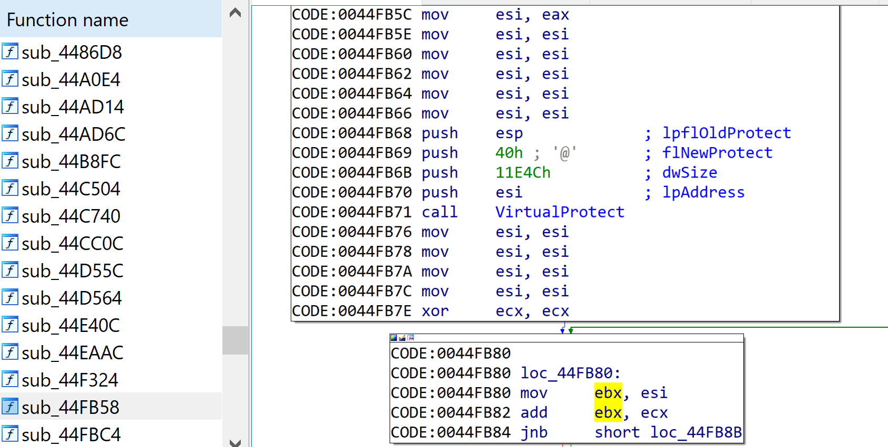
Why Function-based Feature
Easier to interpret than byte or basic block
Often reused in a same malware family
Malware is rarely implemented from scratch
Functions and their relationships are focused on during analysis
→ Function Call Graph (FCG)
Notes:
So, we chose function-based feature because it’s easier to interpret than byte or basic block. Functions are often reused in a same malware family and malware is rarely implemented from scratch. Furthermore, functions and their relationships are focused on during analysis using tools such as IDA Pro. So, we decided to use Function Call Graph, which can reflect the relationships between functions.

Slide 8
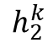
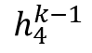
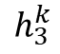
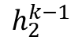
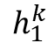
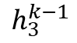
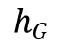
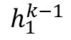
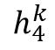
Graph Neural Network (GNN)
Updating feature to reflect the graph structure
AGGREGATE:
COMBINE:
READOUT:
COMBINE
update
Aggregate features of neighboring nodes
AGGREGATE
Update the features of the node to be updated using the neighboring nodes
$$h_{2}^{k−1}$$
$$h_{2}^{k}$$
$$h_{1}^{k}$$
$$h_{4}^{k}$$
$$h_{1}^{k−1}$$
$$h_{4}^{k−1}$$
$$h_{3}^{k}$$
Obtain a representation of the entire graph from the nodes in the graph
$$h_{3}^{k−1}$$
READOUT
$$h_{G}$$
Notes:
We use Graph Neural Network to classify Function Call Graph. GNN updates feature to reflect the graph structure. The graph classification is processed in three main steps.
In this Figure, we consider updating the feature of the red node. First, aggregate the features of the neighboring nodes using AGGREGATE function. Then, COMBINE function updates the feature of the node to be updated using the neighboring nodes. By repeating this process for other nodes, we can obtain features that reflect the graph structure. The features of nearby nodes are aggregated, while those of distant nodes are less taken into account.
Finally, using READOUT function, we can obtain a vector that represents the entire graph.

Slide 9
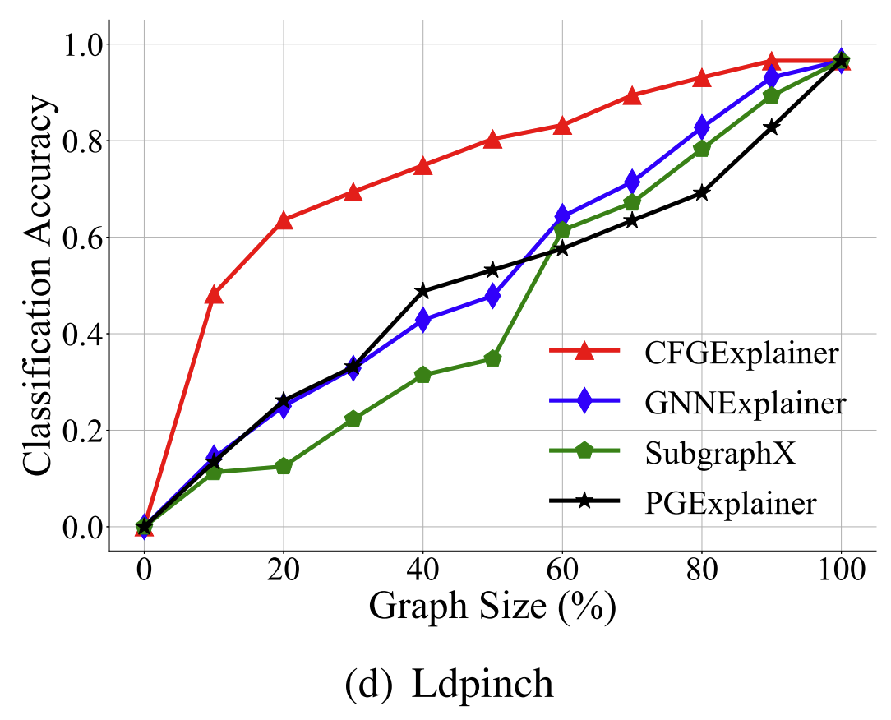
Related Work: CFGExplainer
Explanation method for GNN-based malware classification models
Uses Control Flow Graph with Basic Blocks as nodes
Identifies subgraph that contributes most to classification by pruning less important nodes
Difference from our research:
CFGExplainer uses basic block, our FCGAT uses function
Herath et al. 2022. “CFGExplainer: Explaining Graph Neural Network-Based Malware Classification from Control Flow Graphs.” In 2022 52nd Annual IEEE/IFIP International Conference on Dependable Systems and Networks (DSN). IEEE.
Notes:
Let me introduce a related work called CFGExplainer. This is an explanation method for GNN-based malware classification models. It uses a Control Flow Graph with Basic Blocks as nodes and identifies the subgraph that contributes the most to the classification by pruning less important nodes.
As shown in this figure on the right, by changing the proportion of nodes, CFGExplainer achieves high performance in subgraph classification compared to other GNN-based explanation methods.
The difference from our research is that CFGExplainer uses basic blocks while our FCGAT uses functions. As we mentioned, we use function to obtain more interpretable explanations.

Slide 10
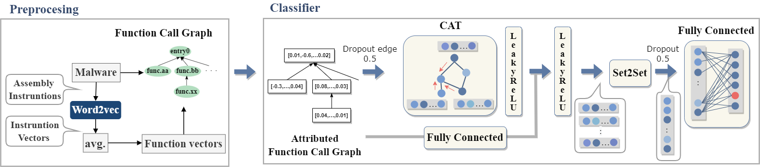
Overview of FCGAT
Preprocessing
Creating Function Call Graph
Creating feature vector of function (function vector)
Classifier
Malware classification using Graph Neural Network
Notes:
This is the overview of FCGAT.
It’s divided into two main parts: preprocessing and classifier.
I’ll explain each of them.

Slide 11
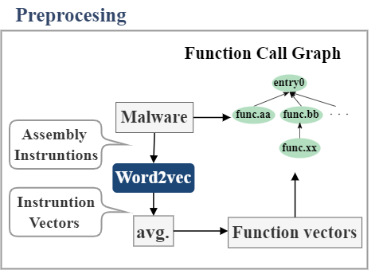
Preprocessing
Creating Function Call Graph
Using IDA Pro
Reversing arrows of FCG
The processing of called function is included in that of calling function
General FCG
Reverse FCG
start
start
sub_00436160
sub_004360b0
sub_00436160
sub_004360b0
sub_004365d0
InternetOpenW
sub_004365d0
InternetOpenW
Notes:
In the preprocessing, FCGAT creates Function Call Graph using IDA Pro.
A general FCG connects edges from calling function to the direction of called function, but FCGAT reverses this arrows. This is because the processing of called function is included in that of calling function. Therefore, the features of called function should be aggregated in calling function, so reverse FCG is used.

Slide 12
Preprocessing
Creating Function Call Graph
Using IDA Pro
Reversing arrow of FCG
Creating function vectors
Using Word2vec for creating instruction vectors
Instruction ↔ word, function ↔ sentence
Averaging instruction vectors in a function to obtain a function vector
Notes:
The next step is creating function vectors.
In this process, assembly instructions are converted to instruction vectors using Word2vec.
In natural language, instructions correspond to words and functions correspond to sentences.
Then, instruction vectors in a function are averaged to obtain a function vector.

Slide 13
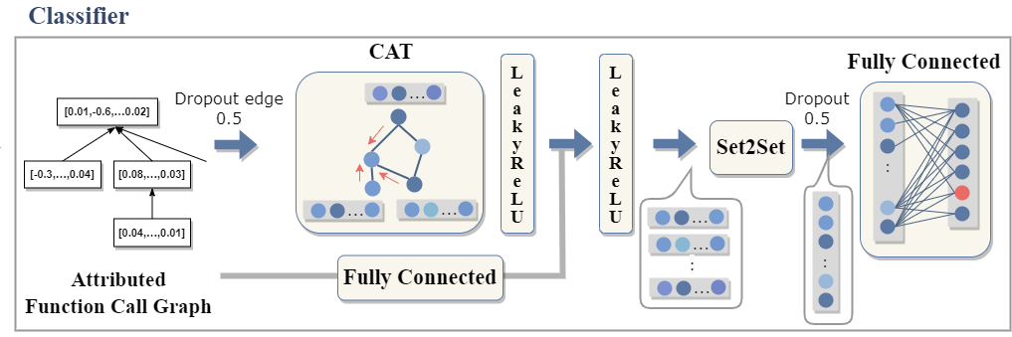
Classifier
Graph Attention Network（GAT）
Updating function vectors using FCG
Set2Set (readout process)
Next slide
Fully Connected (final layer)
Classifying into a number of classes
Notes:
In the Classifier, the input is the FCG with the function vectors and Graph Attention Network is used to update the function vectors to reflect the structure of the FCG.
The readout process uses set2set, I’ll explain it in the next slide.
Finally, fully connected layer classifies into a number of classes.

Slide 14
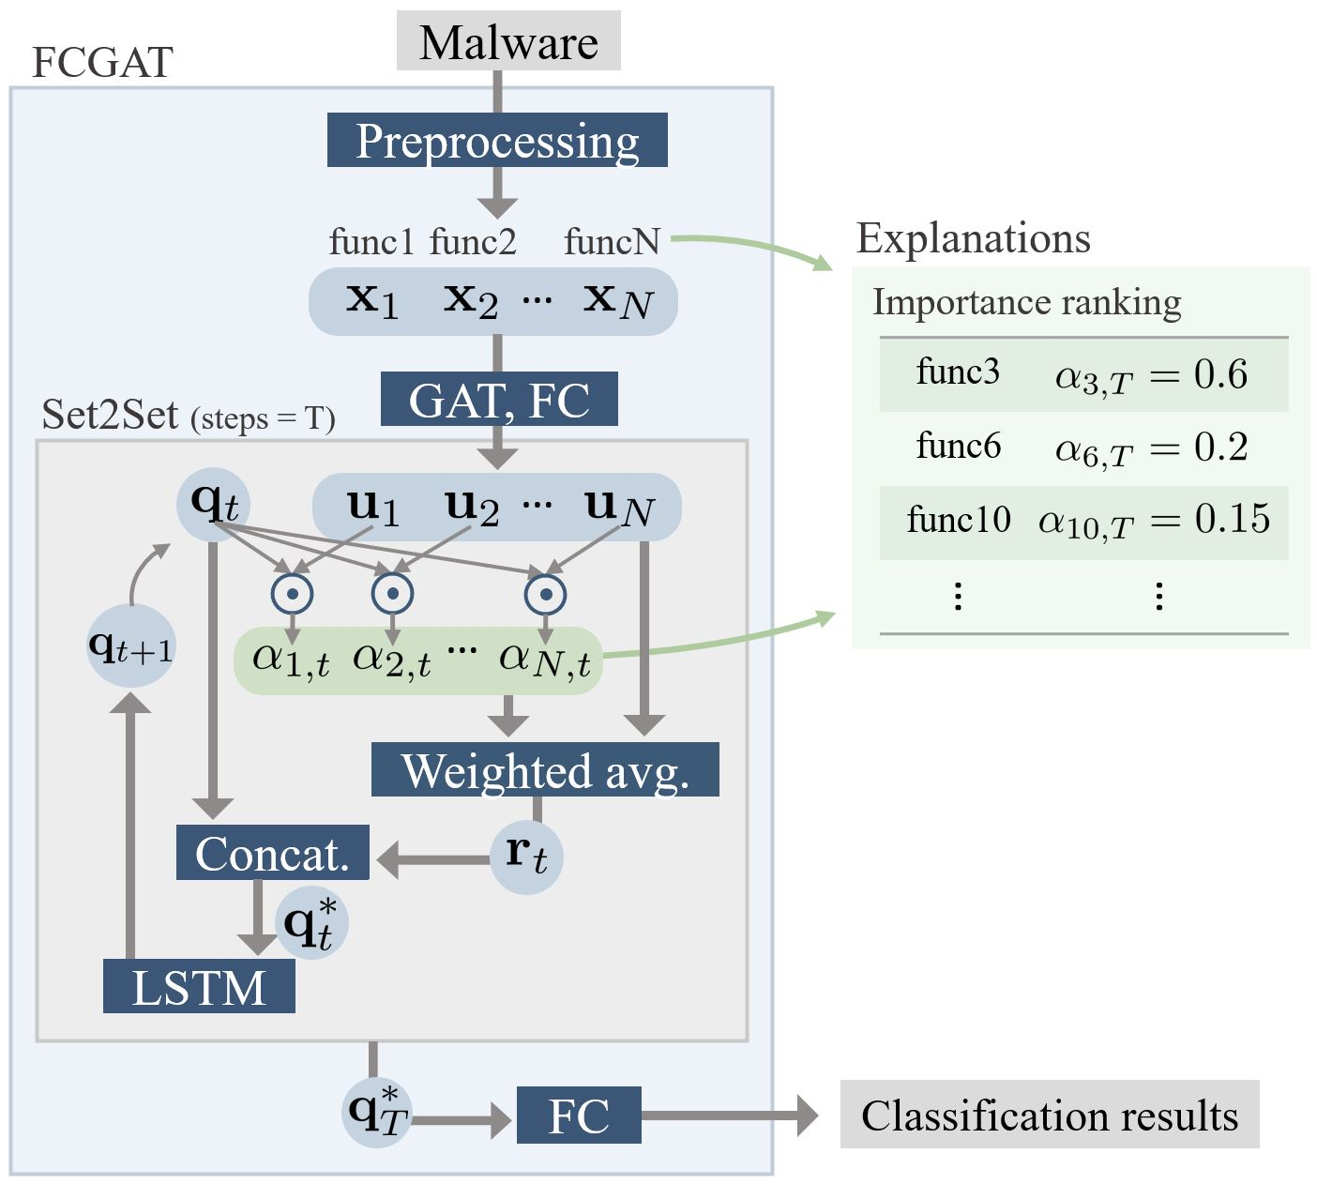

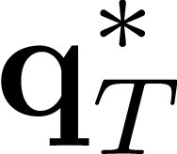
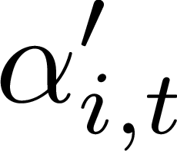
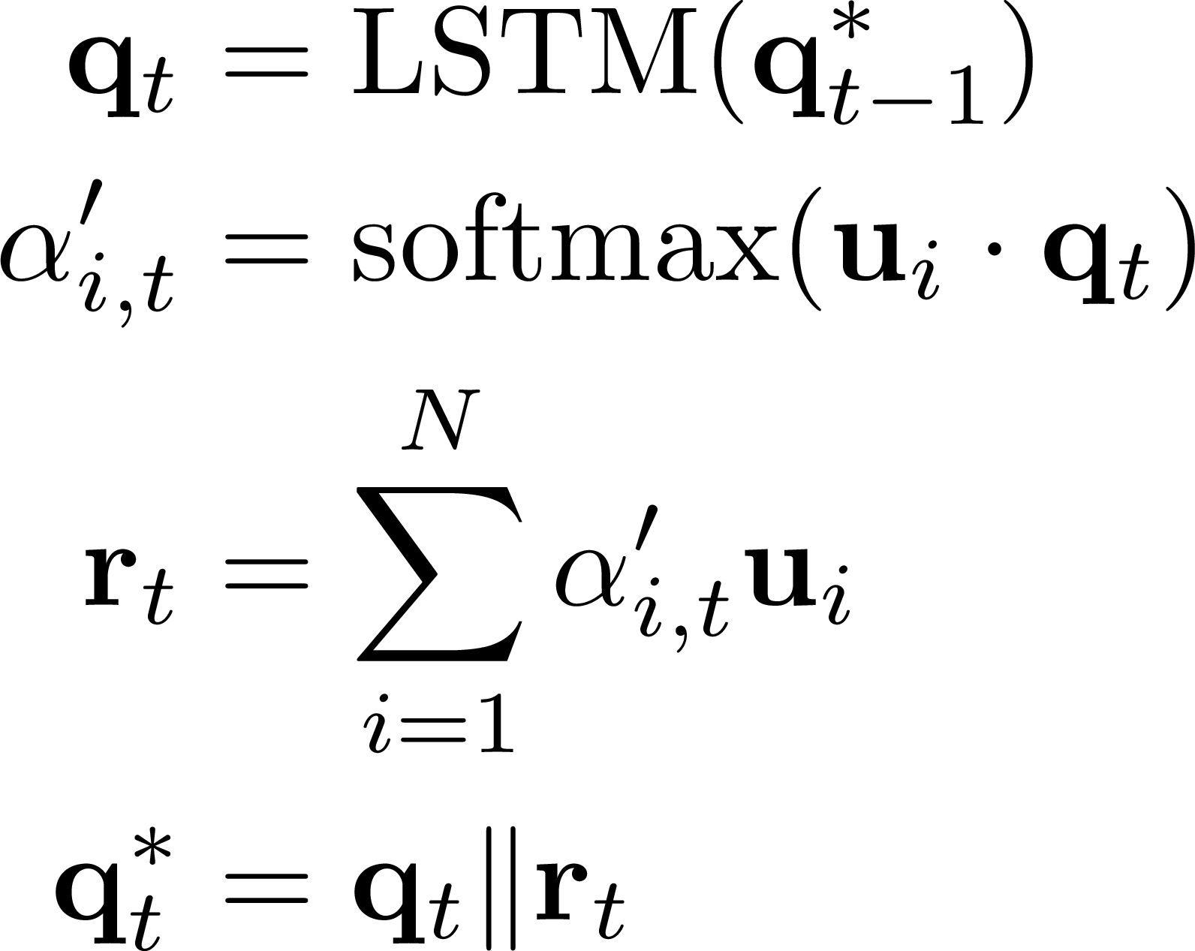
Set2Set (readout process)
The key to interpretability
Inputs : Updated function feature Outputs: Feature of the malware
A larger (attention weight) is assigned to the more important function vector
Importance ranking of function is provided
Notes:
The key to interpretability is Set2Set used in the readout process.
This layer takes u vector which is the updated function feature by Graph Attention Network as input and outputs qT* as the feature of the malware. It takes the weighted average of u with the attention weight α. α is computed by the inner product of qt and u. It’s expected that high attention will be paid to the node features that are important for classification.
We can obtain important functions by analyzing the α’s value.
When explaining the classification results, FCGAT provides the importance ranking with the function name and the importance α.

Slide 15
Experiments
Classification Performance
Perform malware family classification
Compare with demonstration results of existing studies by Ma et al.
Conduct a replicated experiment of GEMAL (using FCG but not interpretable)
Classification Interpretability
Perform malware category classification
Extract the importance ranking of functions as explanations
Confirm the effectiveness of these explanations
Ma, Yixuan et al. 2021. “A Comprehensive Study on Learning-Based PE Malware Family Classification Methods.” In Proceedings of the 29th ACM Joint Meeting on European Software Engineering Conference and Symposium on the Foundations of Software Engineering, 1314–25. ESEC/FSE 2021.
Wu, Xiao-Wang et al. 2022. “Embedding Vector Generation Based on Function Call Graph for Effective Malware Detection and Classification.” Neural Computing & Applications.
Notes:
Moving on to the experiments.
We conducted two types of experiments.
The first is classification performance.
We perform malware family classification and compare it with the results of existing methods.
Ma et al. evaluated the performance of several major methods and we compare our results with those.
We conduct a replication experiment of GEMAL method which uses FCG but is not interpretable.
The other is classification interpretability.
In this experiment, we perform malware category classification and extract the importance ranking of the functions as explanations and confirm the effectiveness of them.

Slide 16
Classification Performance
Category | Model | MalwareBazaar dataset |  |  |  | BIG-2015
 |  | Accuracy | Precision | Recall | F1-Score | Accuracy | Precision | Recall | F1-Score
Image | ResNet-50 | 96.68 | 96.91 | 96.75 | 96.83 | 98.42 | 96.57 | 95.68 | 96.08
 | VGG-16 | 96.35 | 96.58 | 96.54 | 96.56 | 93.94 | 90.32 | 81.89 | 87.27
 | Inception-V3 | 95.83 | 95.67 | 95.79 | 95.73 | 96.99 | 93.67 | 94.46 | 94.03
 | IMCFN | 97.38 | 97.53 | 97.41 | 97.47 | 97.77 | 95.93 | 94.81 | 95.13
Binary | CBOW+MLP | 97.81 | 97.92 | 98.08 | 98.00 | 98.41 | 97.63 | 96.67 | 97.12
 | MalConv | 95.92 | 96.04 | 96.43 | 96.20 | 97.02 | 94.34 | 92.62 | 93.33
Disassembly | MAGIC | 92.82 | 88.03 | 87.36 | 87.45 | 98.05 | 96.75 | 94.03 | 95.14
 | Word2vec+KNN | 95.64 | 93.34 | 94.29 | 93.79 | 98.07 | 96.41 | 96.51 | 96.45
 | MCSC | 96.80 | 94.97 | 94.51 | 94.70 | 97.94 | 95.97 | 96.17 | 96.06
 | FCGAT | 98.11 | 98.03 | 98.27 | 98.15 | 99.27 | 97.93 | 98.45 | 98.18
 | GEMAL | 97.71 | 97.65 | 98.00 | 97.82 | 99.37 | 98.26 | 98.48 | 98.37
by Ma et al.
by us
FCGAT outperforms all other methods
on all metrics
FCGAT is equivalent to
the replication experiment of GEMAL
Notes:
This is the result of the classification performance experiment.
We experimented on two datasets: MalwareBazaar dataset and BIG-2015.
The blue area is the FCGAT, the bottom row shows the results of GEMAL replication experiment by us, and the others are cited from Ma et al.
In MalwareBazaar dataset, FCGAT outperforms all the other methods on all metrics.
In BIG-2015, FCGAT is equivalent to GEMAL.
So, FCGAT achieves high performance competitive with cutting-edge methods.

Slide 17
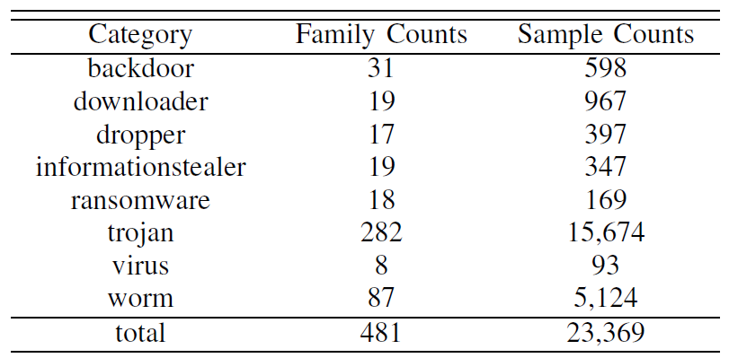
Classification Interpretability
Malware category classification
Malicious behavior is more common in categories
Dataset: BODMAS-8cat
Exclude packed samples detected by peid from BODMAS
Yang, Limin et al. 2021. “BODMAS: An Open Dataset for Learning Based Temporal Analysis of PE Malware.” In 2021 IEEE Security and Privacy Workshops (SPW), 78–84.
Notes:
Next, let's look at interpretability.
In this experiment, we performed malware category classification, because malicious behavior is considered to be more common in categories than in families.
For example, In the case of downloader, an Internet communication function is expected to be important for classification, and in the case of ransomware, an encryption function is expected to be important.
About the dataset, we created BODMAS-8cat, which is part of the BODMAS dataset.
We would like to focus on the characteristics of malware, so we excluded as many packed samples as possible.
We used peid and excluded pack-detected samples from the BODMAS dataset.
In this way, we obtained BODMAS-8cat shown in the table, and experimented using this.

Slide 18
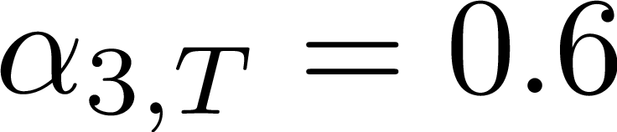
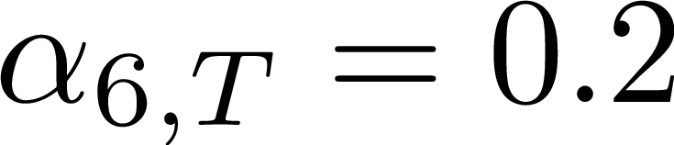
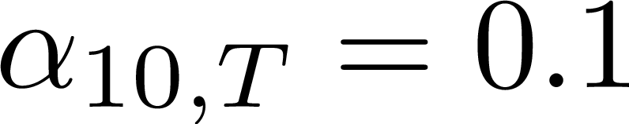
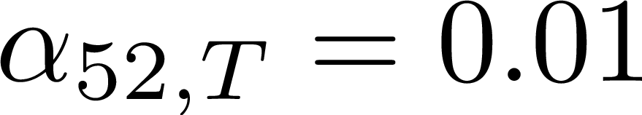
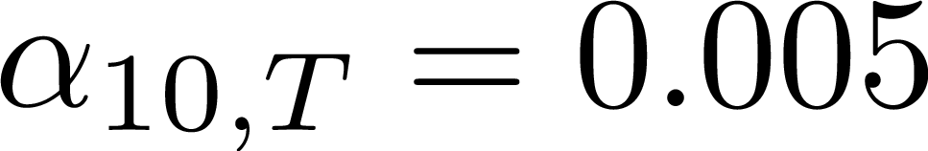
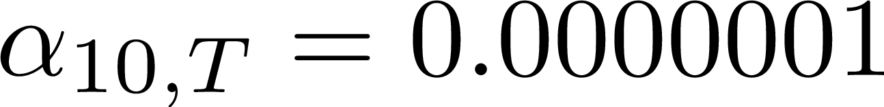
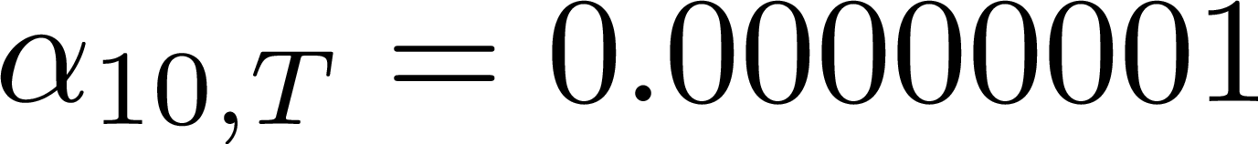
How much do important functions contribute to classification?
Measuring the classification performances of subgraphs
Importance ranking
func3
func6
func10
func52
func30
func70
func33
1%
subgraph
…
10%
subgraph
Evaluate
classification performance
…
…
90%
subgraph
100%
subgraph
= original graph
Notes:
How much do important functions contribute to classification? To verify that, we measured the classification performance of subgraphs.
This method is based on the CFGExplainer’s experiment mentioned in a related work.
A trained model was created using BODMAS-8cat dataset, and the attention weight was calculated for each function in each sample.
We created subgraphs from the top of the ranking with different percentages of nodes in the graph and evaluated classification performance.
If a small subgraph shows high classification performance, we can say that FCGAT is paying attention to functions that contribute highly to classification.

Slide 19
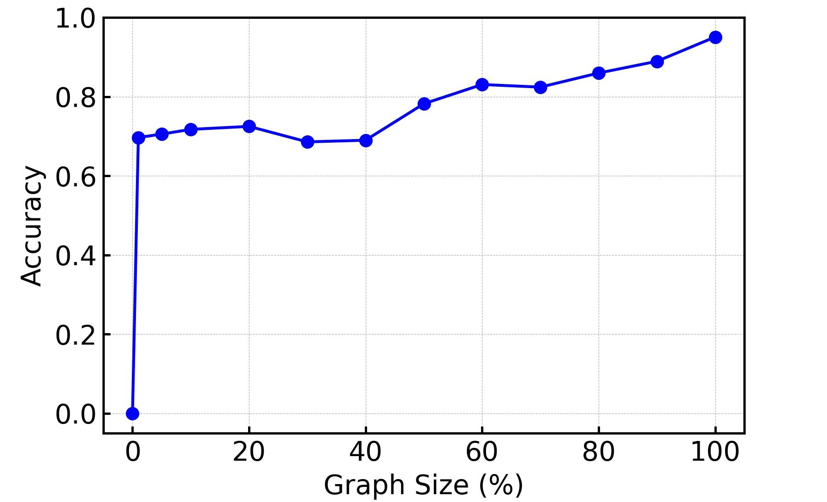
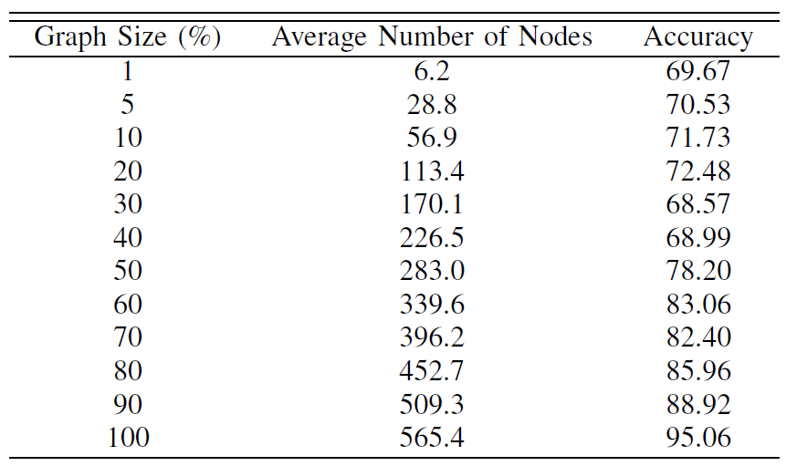
Classification Accuracies of Subgraphs
Only top 6 functions (average per sample) achieve 69.67% accuracy
Comparison with existing study
CFGExplainer showed 52.39% accuracy in the 10% subgraph
FCGAT achieves 71.73% accuracy !
Using function, malware can be characterized with a small number of nodes
Notes:
Here are the accuracies for the subgraphs.
The graph shows accuracies as a percentage of the number of nodes, and the table below shows the values and the average number of nodes.
Only top 6 functions (average per sample) achieve 69.67% accuracy.
Compared to existing study, CFGExplainer achieves 52.39% accuracy in the 10% subgraph, while FCGAT achieves 71.73% accuracy.
We found that using function, malware can be characterized with a small number of nodes.

Slide 20
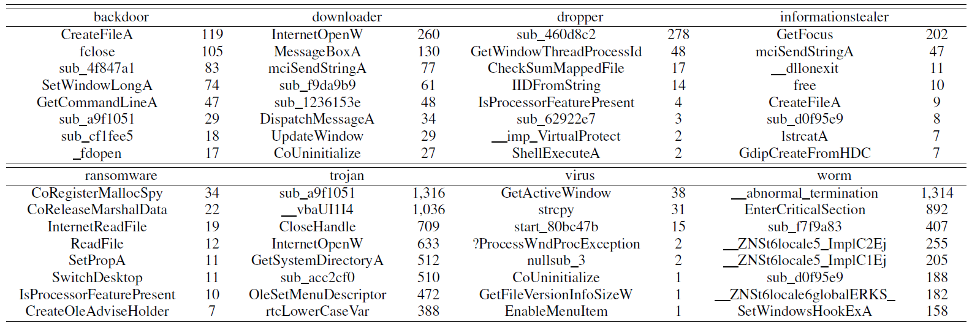
Trend Analysis of Malware Categories
Some functions reflect category characteristics
Aggregate results for each category of functions with max attention weights
Notes:
We can perform trend analysis for each malware category by analyzing the important functions.
We extracted the functions with the max attention weight from each sample and aggregated them by category.
The top 8 functions are shown in the table.
We can see some functions reflect category characteristics.
For example, Backdoor is placed on the victim machine by the attacker and enable it to be controlled remotely. So GetCommandLineA reflects the feature of reading command line parameters.
In Downloader, we can see FCGAT focused on InternetOpenW which is used when downloading another malware from the Internet. This result highly reflects the characteristics of downloader.

Slide 21
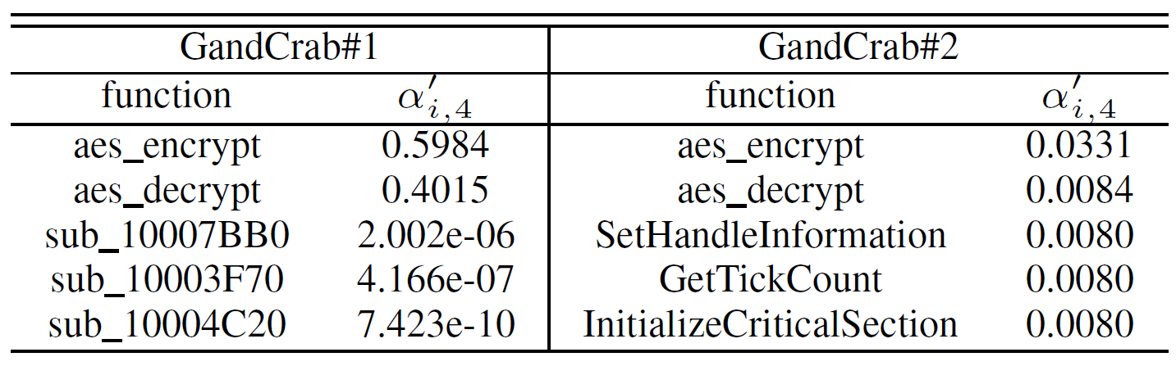
Case Study: Ransomware/ GandCrab
GandCrab is ransomware that appeared in 2018
We will see two samples, GandCrab#1 and GandCrab#2
These samples are common to the top two important functions, aes_encrypt and aes_decrypt, which are characteristic of ransomware
DLL file
EXE file
Notes:
Finally, as a case study, we will see a GandCrab, a ransomware that appeared in 2018.
We look at GandCrab#1 and #2 and their importance ranking of the functions.
Note that GandCrab#1 is a DLL file and #2 is an EXE file, and their program structures are quite different.
However, by focusing on the common functions aes_encrypt and aes_decrypt, FCGAT were able to correctly classify them. This suggests that FCGAT is flexible enough to capture the characteristics of programs that are structurally different but semantically similar.
In this case, it is easy to guess the behavior from the function name because the function name is named by IDA pro's Lumina server.
Even if it’s difficult to guess from the function name, FCGAT can focus on characteristic functions because it uses assembly code. We believe that these explanations are useful for malware analysis.

Slide 22
Conclusion
Proposed FCGAT
The first study to explain malware classification on a per function basis
Evaluated classification performance
High performance competitive to the latest method
Confirmed the effectiveness of the explanations
Functions that reflect the malware feature
A small number of functions characterizing malware
Contact: mgs227501@iisec.ac.jp
Notes:
Conclusion.
We have proposed FCGAT. To the best of our knowledge, this is the first study to explain malware classification on a per-function basis.
We evaluated its classification performance and found that it achieves high performance competitive to the latest method.
Finally, we confirmed the effectiveness of the explanations.
We have seen functions that reflect the malware feature.
We showed that a small number of functions can characterize malware.
The contact address is here. Thank you for your attention.

